Slide 1


Malcomb C. Brown
Jan. 8, 2022

Slide 2

Outline
Executive Summary
Introduction
Methodology
Results
Conclusion
Appendix

Slide 3
Executive Summary
Ability to develop a cost analysis for our rockets based on expected successful landing
Collecting, wrangling, and analyzing SpaceX Falcon 9 launch data
Able to predict successful landings with over 80% accuracy

Slide 4
Introduction
Reducing the cost of rockets
Being able to reuse the rockets
What are the factors contributing to a successful landing?
Launch Site
Payload Mass
Orbit
Able to correctly predict successful landings with over 80% accuracy

Slide 5


Slide 6
Methodology
Executive Summary
Data collection methodology:
Gathering past launch data using the SpaceX REST API
Web Scraping relevant Wiki pages with the Python library Beautiful Soup
Perform data wrangling
Deal with any missing data and null values
Convert landing outcomes to allow for classification models
Perform exploratory data analysis (EDA) using visualization and SQL
Perform interactive visual analytics using Folium and Plotly Dash
Perform predictive analysis using classification models
How to build, tune, evaluate classification models

Slide 7
Data Collection
How data sets were collected.
Acquiring past launch data using the SpaceX REST API
Use of the requests library to obtain the information from the API as a JSON file
Convert the JSON data into a data frame with the Pandas library
Web Scraping Falcon 9 launch data from Wiki pages using the Python Beautiful Soup library
Parse and Convert the HTML tables to a Pandas data frame

Slide 8
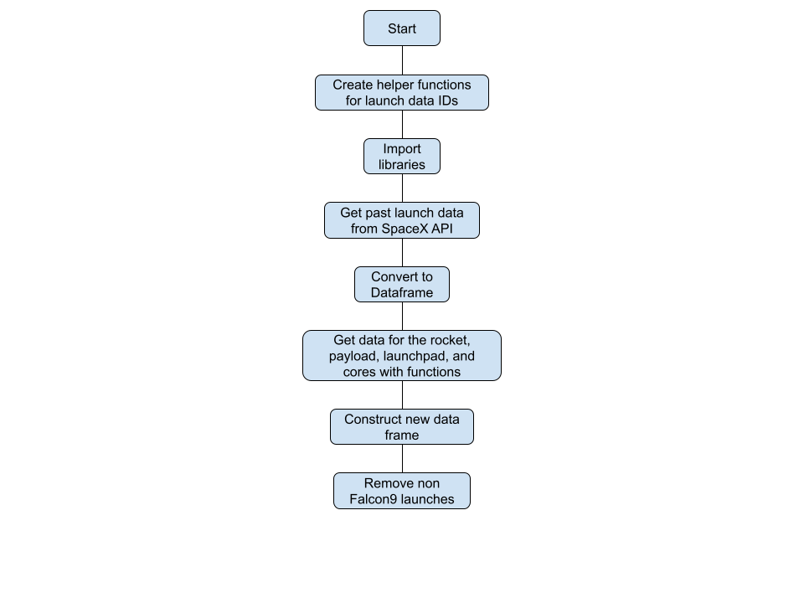
Data Collection – SpaceX API
Request and Parse launch data with a GET request
Retrieve specific data on the rocket, payload, launch pad, and cores
Filter the resulting data frame to only include Falcon9 launches
https://github.com/Ash021980/spaceyibmcap/blob/main/Data%20Collection%20API%20Lab.ipynb

Slide 9
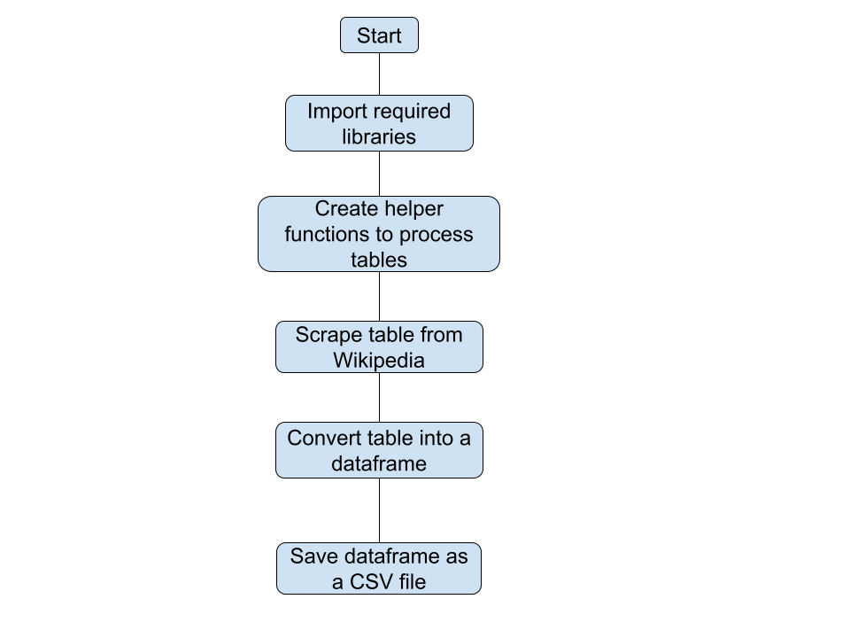
Data Collection - Scraping
Extract Falcon9 launch records HTML table from Wikipedia with Beautiful Soup
Parse the table and convert it to a Pandas data frame
https://github.com/Ash021980/spaceyibmcap/blob/main/Data%20Collection%20with%20Web%20Scraping.ipynb

Slide 10
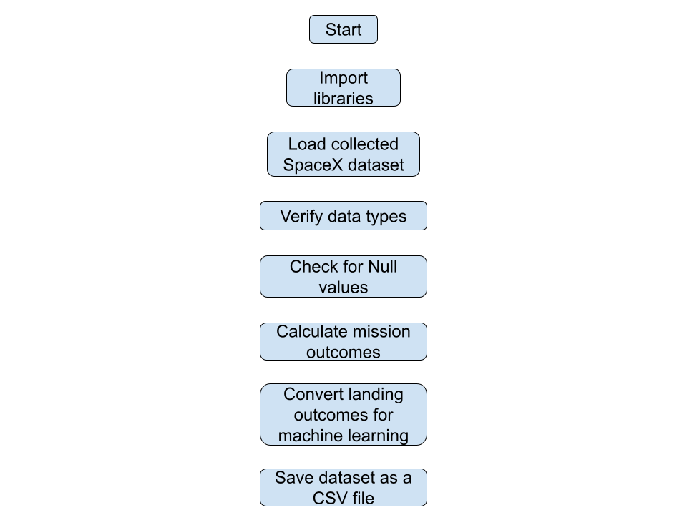
Data Wrangling
Performed EDA on collected SpaceX data
Verify and clean data set
Handle Null values in data
Handle any data type inconsistencies
Determine relevant training labels
Transformed landing outcomes to success, 1, and failure, 2, class
https://github.com/Ash021980/spaceyibmcap/blob/main/Data%20Wrangling%20Lab.ipynb

Slide 11
EDA with Data Visualization
Categorical plots were used to see the effects different categories have on the success rate of the landing outcome.
A bar chart was used to view the relationship between the landing outcome success rate and the type of orbit.
A line plot was used to visualize the success rate trend over time.
https://github.com/Ash021980/spaceyibmcap/blob/main/SpaceY%20Visualizations%20.ipynb

Slide 12
EDA with SQL
What unique launch sites have been used?
What the average pay load mass carried by a Falcon9 v1.1 booster?
When was the first successful landing outcome achieved on a ground pad?
What is the total number of successful and failed missions?
What was the total number of landing outcomes from 2010-06-04 and 2017-03-20 and rank them?
https://github.com/Ash021980/spaceyibmcap/blob/main/EDA%20with%20SQL%20.ipynb

Slide 13
Build an Interactive Map with Folium
Initialize a Folium Map object to get an interactive map
Marker objects identify launch site locations.
Marker Clusters visualize successful and failed launch outcomes at each launch site.
Circles allowed for the highlighting specific coordinates and overlaying text labels.
Mouse position provided for the viewing latitude and longitude for a mouse over on the map.
Polylines provided lines from launch sites and specified map coordinates.
https://github.com/Ash021980/spaceyibmcap/blob/main/Interactive%20Visual%20Analytics%20with%20Folium.ipynb

Slide 14
Build a Dashboard with Plotly Dash
Display the success rates for each launch site in a Pie chart.
Controlled with a dropdown menu to drilldown by specific site
Categorical plot to visualize the success rate for each booster version and by its pay load mass.
Pay load mass can be adjusted by a slider
https://github.com/Ash021980/spaceyibmcap/blob/main/spacex_dash_app.py.ipynb

Slide 15
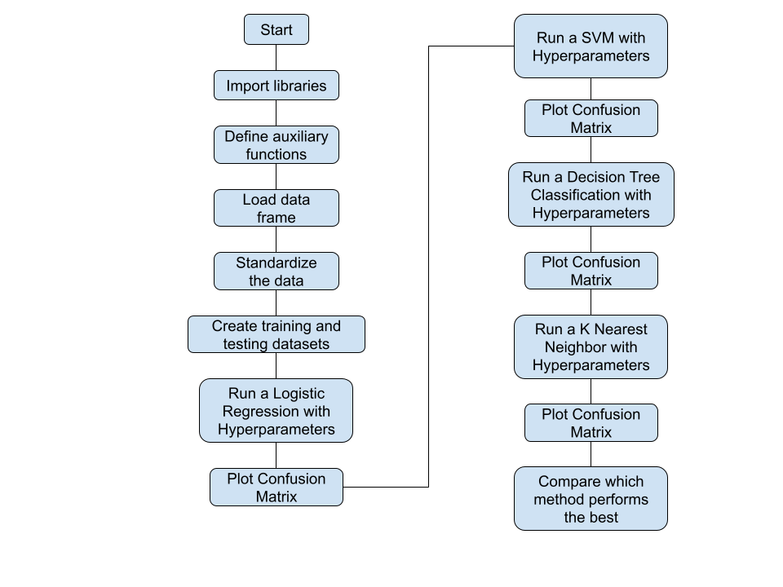
Predictive Analysis (Classification)
Feature Engineering
Create dummy variables for categorical columns
Cast all numeric columns as float64
Perform exploratory data analysis and determine training labels
Create a column for the class
Standardize the data
Split the data into training and testing datasets
Find the best hyperparameters for SVM, Classification Trees, and Logistic Regression
Find the method that performs best using test data
https://github.com/Ash021980/spaceyibmcap/blob/main/Machine%20Learning%20Prediction%20Lab.ipynb

Slide 16
Results
Exploratory data analysis results
Located the 4 launch sites used
Total number of successful and failed mission outcomes
Total for each type of landing outcome
Interactive analytics
Launch site proximity to railways, highways, and coastline
Distance from launch site to nearest city
Predictive analysis results
No significant difference in the accuracy among the models
Decision Tree Classification showed the only improvement over the training and testing sets

Slide 17


Slide 18
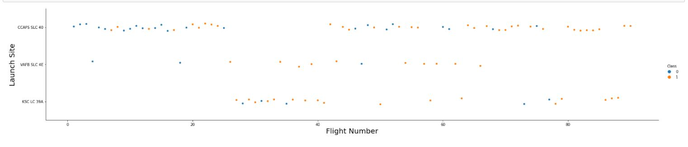
Flight Number vs. Launch Site
Visualize the landing outcome for each flight.
Became more successful as more flights were done. (Experience)
Most flights originate from CCAFS SLC-40.
KSC LC-39A and VAFB SLC-4E have high success rates but low usage.

Slide 19
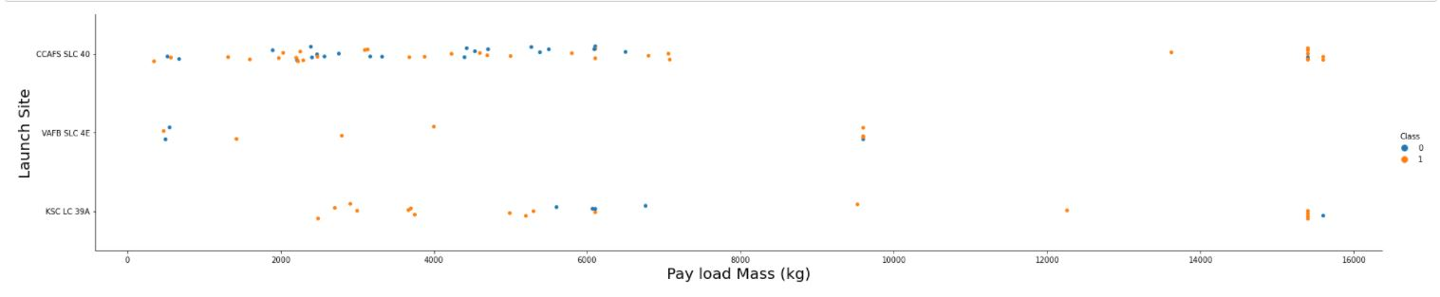
Payload vs. Launch Site
Plot the landing outcome by launch site and pay load mass (kg).
Success rate increases for payloads over 10,000 kg.
VAFB SLC-4E has no launches with a payload over 10,000 kg.
KSC LC-39A has only successful landing outcomes with a payload mass less than 5,000 kg.

Slide 20
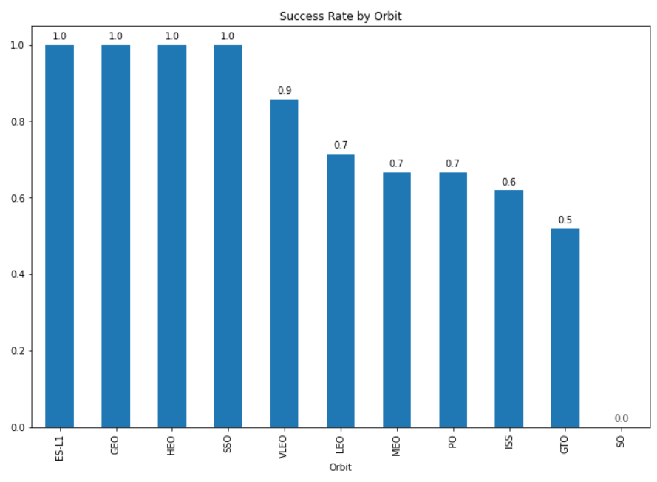
Success Rate vs. Orbit Type
Orbits with highest success rate:
ES-L1
GEO
HEO
SSO
VLEO

Slide 21
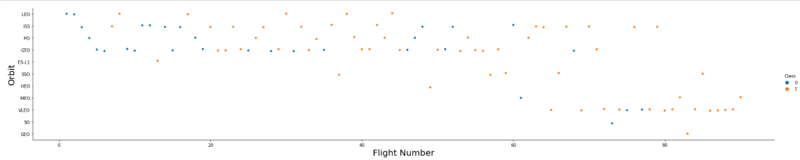
Flight Number vs. Orbit Type
Orbits with 100% success rate have only completed 5 or fewer flights.
SSO is the only one with more than 1 flight
VLEO, with a 90% success rate, is the most frequented orbit after the 60th flight.
Success rate increases with the number of flights to a specific orbit.

Slide 22
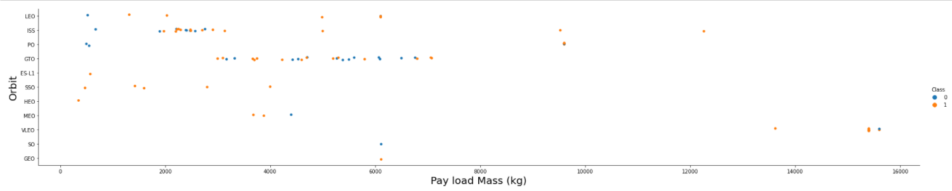
Payload vs. Orbit Type
Heavy pay loads, over 10,000 kg, have positive success rates to the Polar, LEO, and ISS orbits.
Pay loads under 5,000 kg have positive success rates to the SSO, ES-L1, and HEO orbits.
Cannot distinguish between positive or negative landing for the GTO orbit.

Slide 23
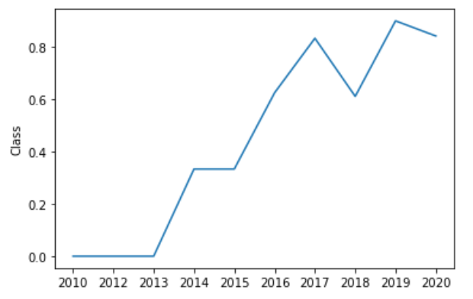
Launch Success Yearly Trend
Since 2013, there has been a steady increase in the success rate.
From 2017 to 2018, there was a significant reduction in the success rate.

Slide 24
All Launch Site Names
Explored the SpaceX historical launch data
Found 4 launch facilities used for launch missions
VAFB SLC 4E , Vandenberg Air Force Base Space Launch Complex 4E
KSC LC 39A, Kennedy Space Center Launch Complex 39A
CCAFS LC-40, Cape Canaveral Space Launch Complex 40
CCAFS SLC-40, Cape Canaveral Space Launch Complex 40
SQL query in Appendix

Slide 25
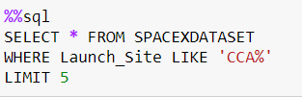
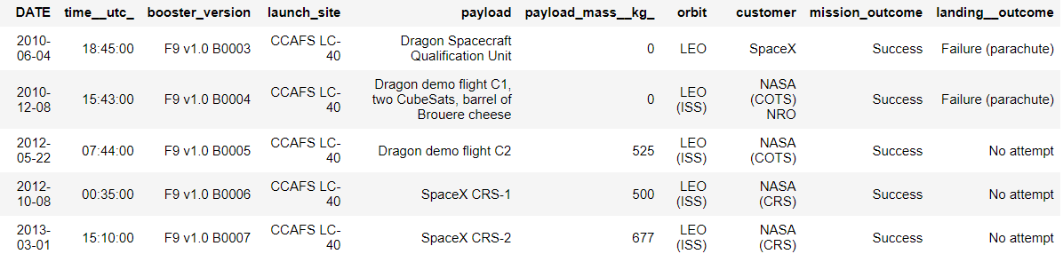
Launch Site Names Begin with 'CCA'
Looked at 5 missions to launch from Cape Canaveral and Merritt Island launch sites
First 5 missions were to LEO
4 of the 5 had NASA as the customer
All missions were successful
No successful attempts to retrieve the first stage

Slide 26
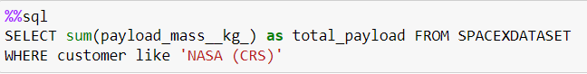
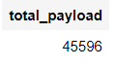
Total Payload Mass
Calculated the total payload carried by boosters from NASA Commercial Resupply Services
Over 45,000 kg, @100,521 lbs., were carried

Slide 27
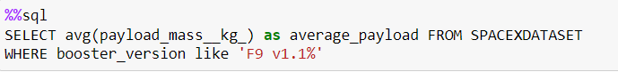
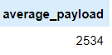
Average Payload Mass by F9 v1.1
Calculated the average payload mass carried by booster version F9 v1.1
On average 2,534 kg, @5,586 lbs., were carried

Slide 28
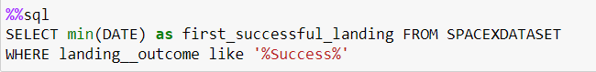
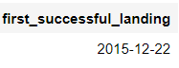
First Successful Ground Landing Date
When was the first successful landing outcome on ground pad?
December 22, 2015
That’s 5 years after the first launch

Slide 29
Successful Drone Ship Landing with Payload between 4000 and 6000
Which boosters successfully landed on drone ship that had payload mass greater than 4000 but less than 6000 kg?
F9 FT B1022
F9 FT B1026
F9 FT B1021.2
F9 FT B1031.2
SQL query and data frame in Appendix

Slide 30
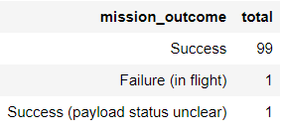
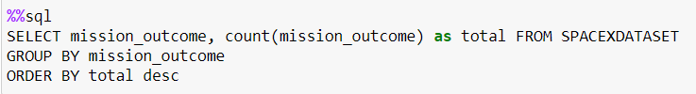
Total Number of Successful and Failure Mission Outcomes
Calculate the total of each mission outcome
There was only 1 failure (in flight)
There were 100 successful missions

Slide 31
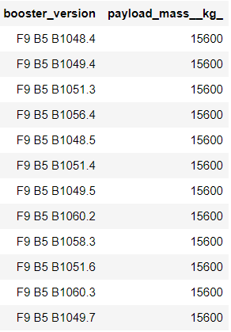
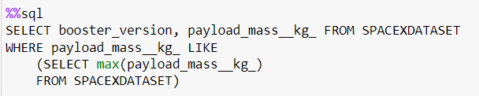
Boosters Carried Maximum Payload
Which booster carried the maximum payload mass?
The F9 B5 booster versions carried the max payload mass, which was 15,600 kg

Slide 32
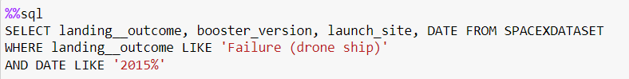
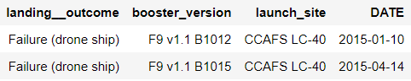
2015 Launch Records
There were 2 failed landing outcomes on drone ships
Both were booster version F9 v1.1
Launched from CCAFS LC-40

Slide 33
Rank Landing Outcomes Between 2010-06-04 and 2017-03-20
Rank of landing outcomes between 2010-06-04 and 2017-03-20
No failed landing outcomes to a ground pad
33% of the time no attempt was made at booster recovery
Landing to a drone ship was successful at rate of 50%
Query and data frame presented in the Appendix

Slide 34


Slide 35
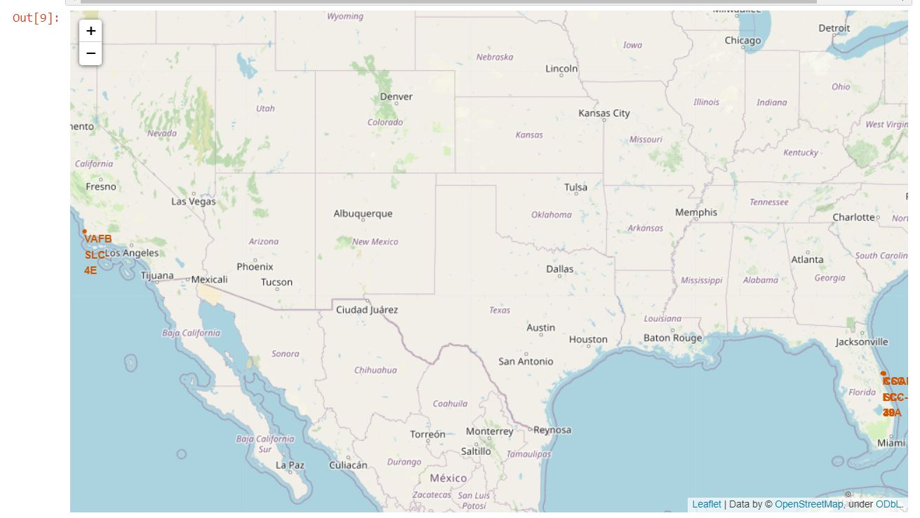
Launch Site Locations
Launch sites located near the coast.
75% of launch sites are in Florida

Slide 36
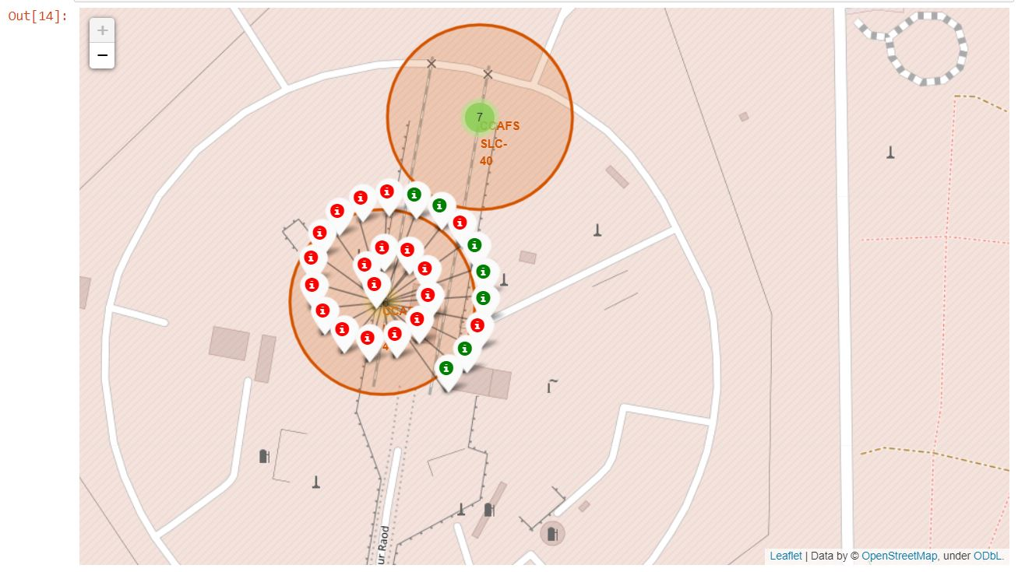
Launch Site Landing Outcomes
Replace <Folium map screenshot 2> title with an appropriate title
Explore the folium map and make a proper screenshot to show the color-labeled launch outcomes on the map
Explain the important elements and findings on the screenshot

Slide 37
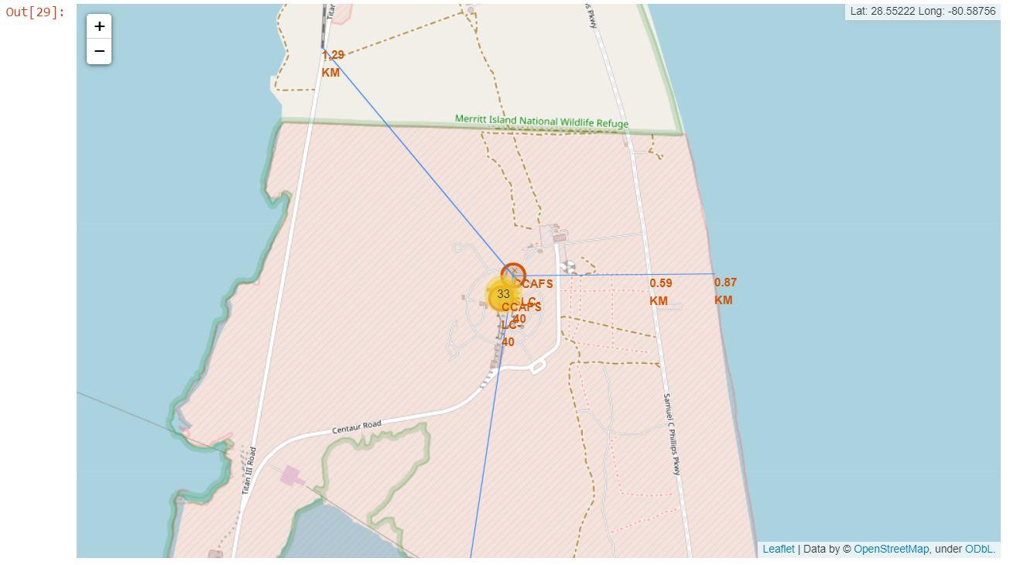
Distances between Launch Site and its Proximities
Launch sites are nearby:
Railways and highways for logistics
Coastlines for safety
Launch sites are not nearby:
Cities for safety

Slide 38


Slide 39
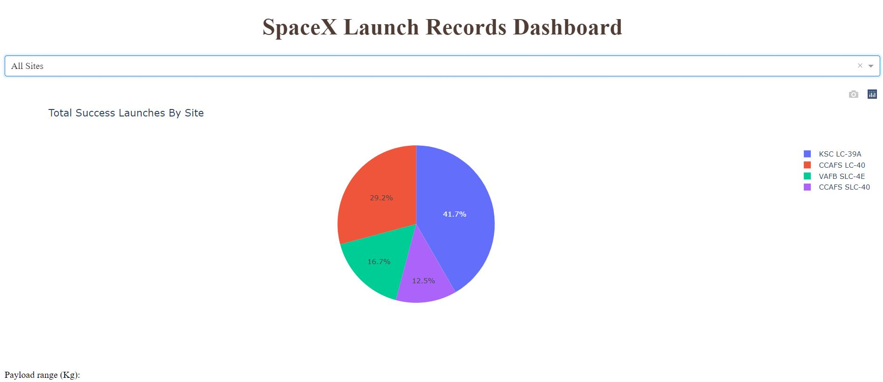
Total Successful Launches
KSC LC-39A has the highest number of successful landing outcomes
VAFB SLC-4E and CCAFS SLC-40 have the least number of successful landings
KSC LC-39A and CCAFS LC-40 have over 70% of all successful landings

Slide 40
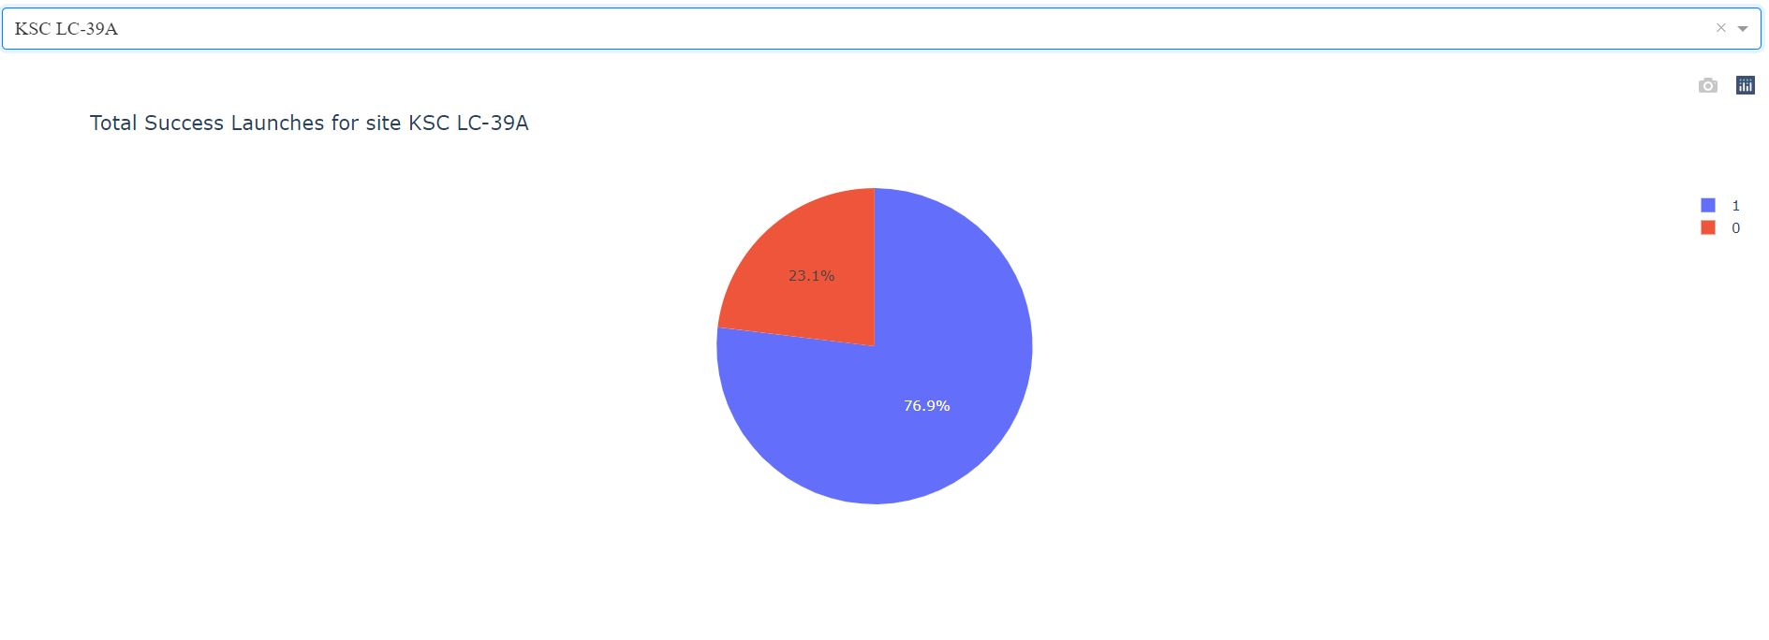
KSC LC-39A Successful vs Failed launches
Over two-thirds of all launches ended successfully
Conducted the second greatest number of total launches
Only 13 launches have been conducted

Slide 41
Payload vs Landing Outcome Success
Falcon9 booster version vFT have the greatest number of successful landing outcomes overall.
Booster vFT also has the highest number of successful landings with a payload mass between 2000kg and 4000kg.
Booster version v1.1 was only successful once and with a payload less than 2000kg.
Booster vB4 has the only successful landing over 6000kg.

Slide 42
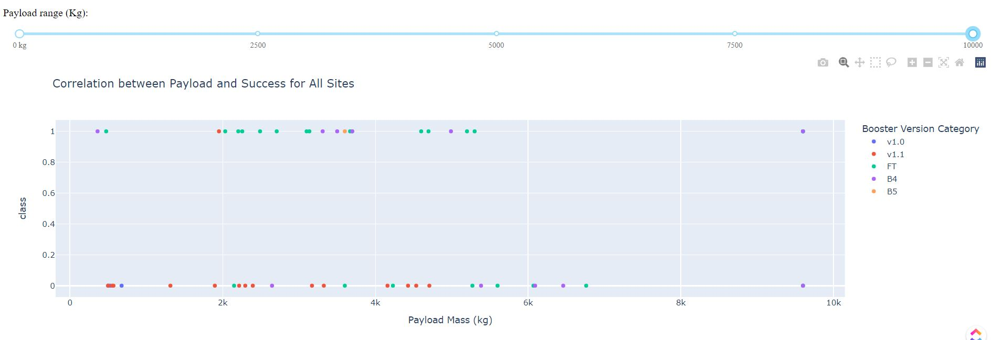
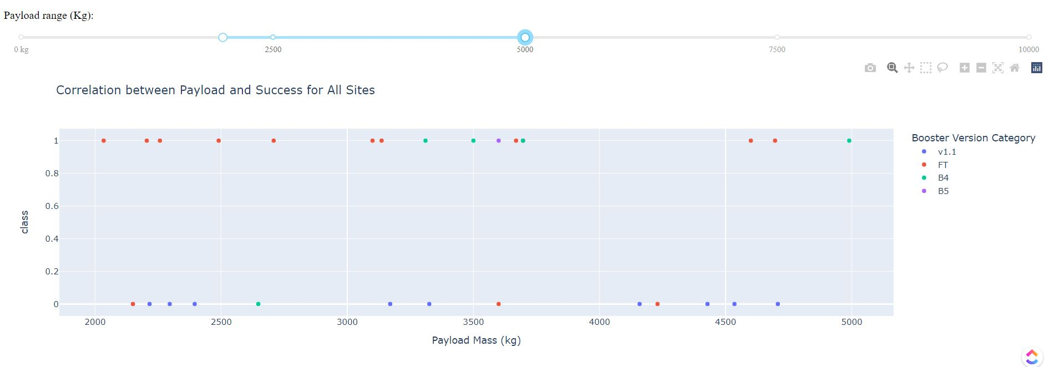
Payload vs Landing Outcome Success

Slide 43
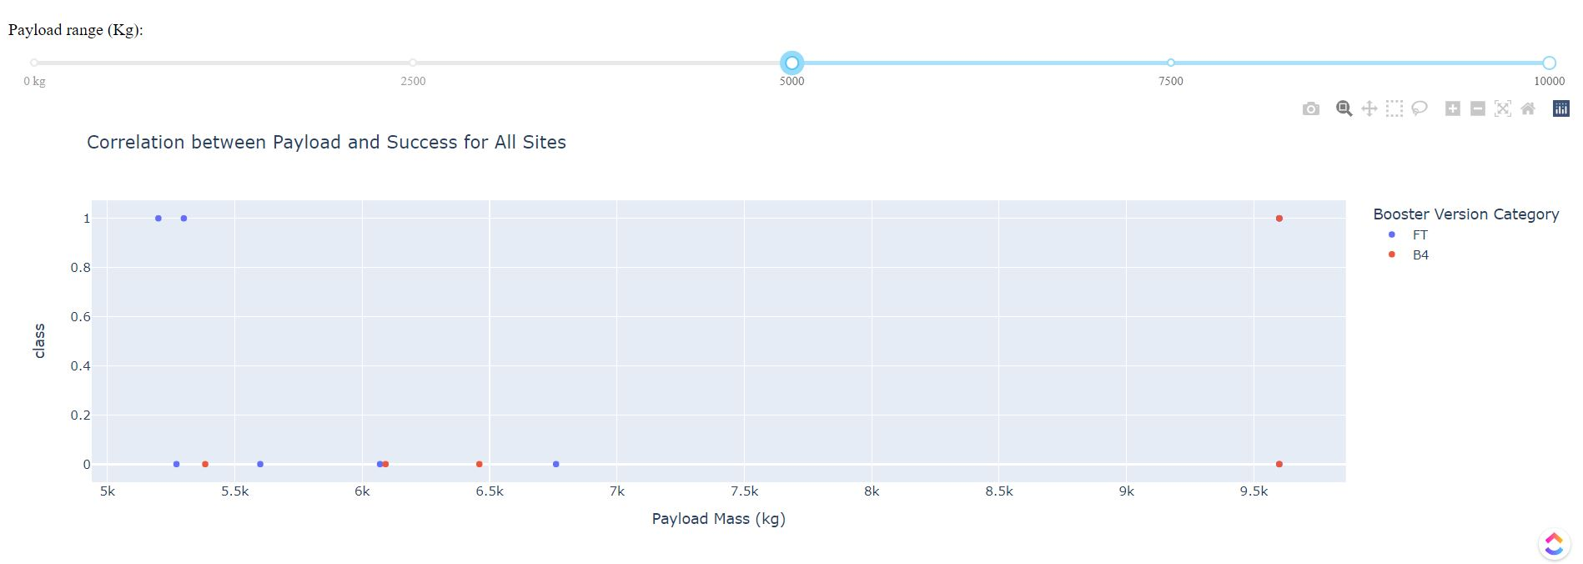
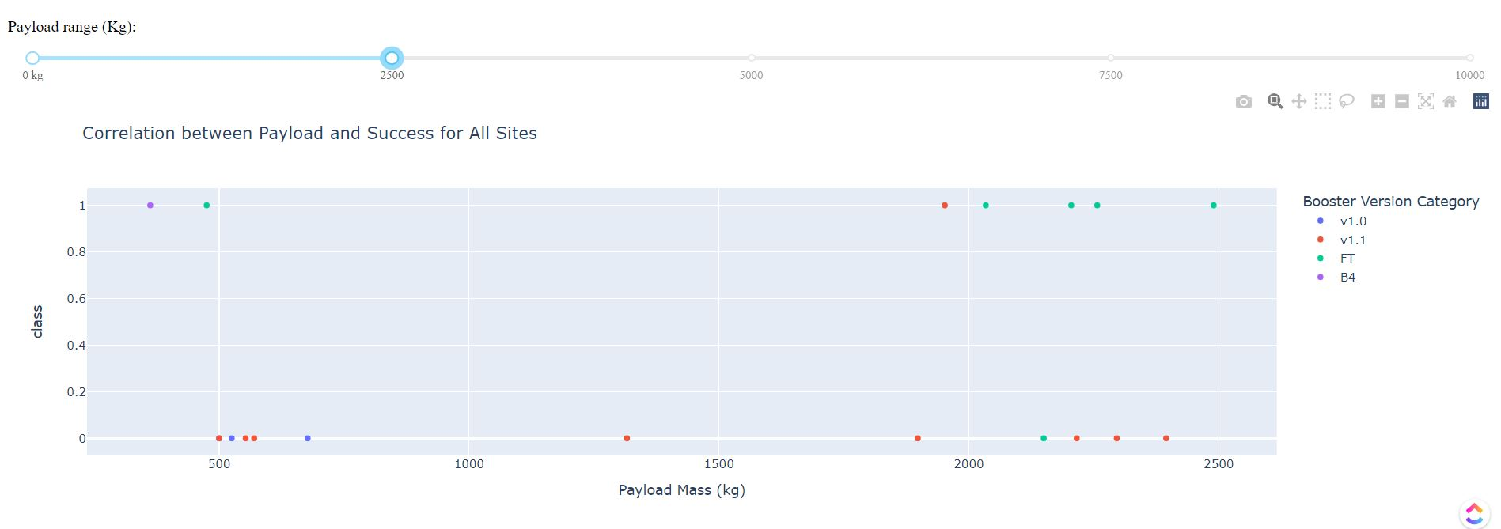
Payload vs Landing Outcome Success

Slide 44


Slide 45
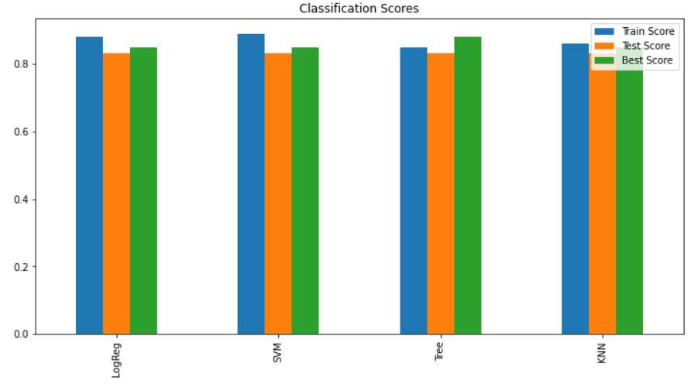
Classification Accuracy
All models have an 83% classification accuracy
When applying hyperparameters, the Decision Tree Classification model is 88% accurate
All other models only improve to an 85% classification accuracy

Slide 46
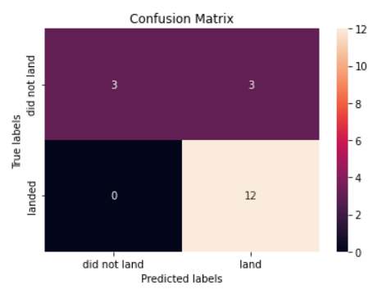
Confusion Matrix
Decision Tree Confusion Matrix
15 landings successfully predicted
3 landing outcomes were predicted unsuccessfully

Slide 47
Conclusions
Timeframe for successful booster recovery
4 to 5 years after first flight
Location of the launch site
KSC LC-39A
CCAFS site complex 40
Pay load mass (in kg)
2,000 kg or less
Booster versions
F9 FT
F9 v1.1
Orbit
SSO
ES-L1
HEO
Try to acquire NASA as a vendor
NASA CRS or Commercial Resupply Services

Slide 48
Appendix
Complete GitHub repo:
https://github.com/Ash021980/spaceyibmcap.git

Slide 49
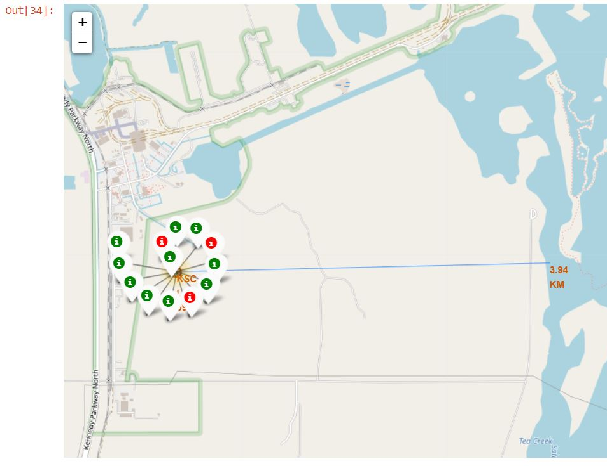
Appendix
KSC LC-39A at 3.94 km from the nearest coastline has the highest success rate and count
Only launch site more than 1.5 km away from a coastline
Has the second highest number of launches

Slide 50
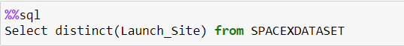
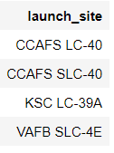
Appendix
Unique Launch Site SQL query
Resulting data frame

Slide 51
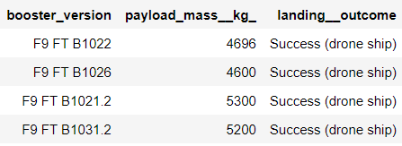
Appendix
Successful drone ship landing outcome with a payload mass between 4000 and 6000 kg SQL query
Resulting data frame

Slide 52
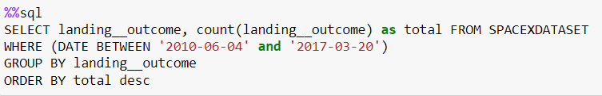
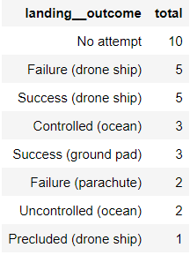
Appendix
Rank of landing outcomes between 2010-06-04 and 2017-03-20

Slide 53
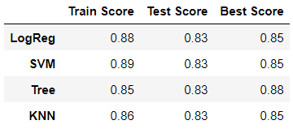
Appendix
Classification data frame

Slide 54


